Slide 1
Disclaimer
We hope you find the information on our website and resources useful.
Animations
This resource has been designed with animations to make it as fun and engaging as possible. To view the content in the correct formatting, please view the PowerPoint in ‘slide show mode’. This takes you from desktop to presentation mode. If you view the slides out of ‘slide show mode’, you may find that some of the text and images overlap each other and/or are difficult to read.
To enter slide show mode, go to the slide show menu tab and select either from beginning or from current slide.
You may wish to delete this slide before beginning the presentation.

Slide 3
Welcome Page
Online Gaming
Making Friends
Online Bullying
Sharing Information
www.onlinesafety.com
The Internet is amazing when used safely and correctly.
Here are some simple rules that will help you stay safe online.
Press to enter!
Loading ….
Be smart and safe by making the right choices.

Slide 4
Welcome Page
Online Gaming
Making Friends
Online Bullying
Sharing Information
www.onlinesafety.com
If you see something online that upsets you:
STOP - Stop what you are doing. Do not click on the page or reply to any messages.
CLOSE - Close the laptop. Put your phone or tablet down.
TELL - Tell a trusted adult.

Slide 5
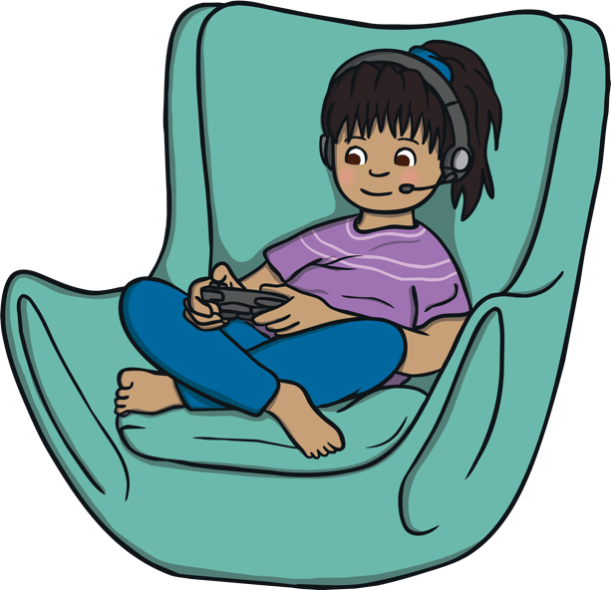
Welcome Page
Online Gaming
Making Friends
Online Bullying
Sharing Information
www.onlinesafety.com/onlinegaming
Online Gaming
Always ask a trusted adult before you play games online.
Use a username instead of your real name when playing games online.
It is important to be nice to people so that you don't upset them. Remember to treat others how you would like to be treated.

Slide 6
Welcome Page
Online Gaming
Making Friends
Online Bullying
Sharing Information
www.onlinesafety.com/makingfriends
Making Friends
Only talk to people you know online. If someone you don’t know sends you a request or message, ask a trusted adult.
Never agree to meet someone in person that you met online. Some people on the Internet might not be who they say they are.

Slide 7
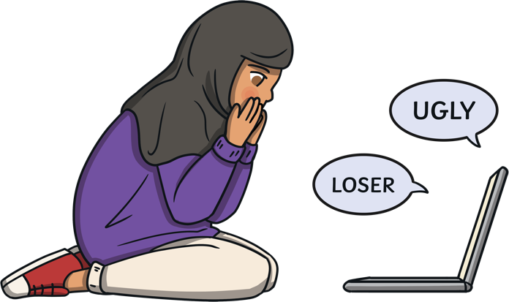
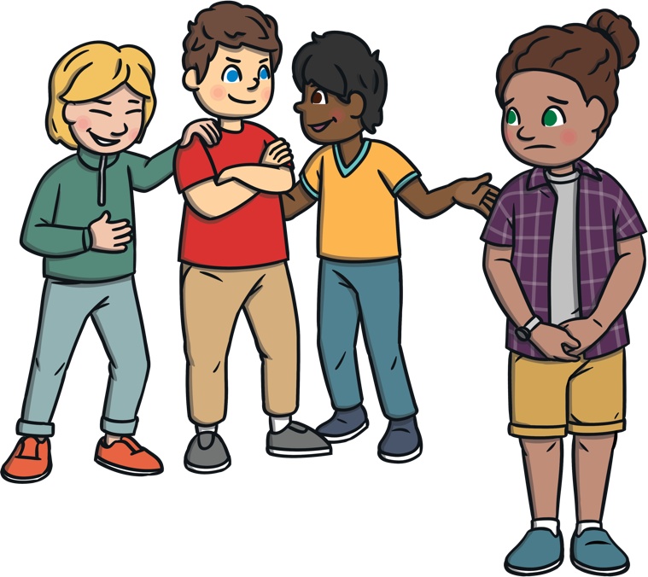
Welcome Page
Online Gaming
Making Friends
Online Bullying
Sharing Information
www.onlinesafety.com/onlinebullying
Online Bullying
Show whatever you receive to a trusted adult, so they can help you.
Online bullying is a type of bullying. It can take place when playing games or talking to people online.
Don’t keep online bullying to yourself! Tell a trusted adult. People want to help you and make it better.
If someone says something that upsets you, tell a trusted adult, such as a teacher or parent, and block the bully.

Slide 8
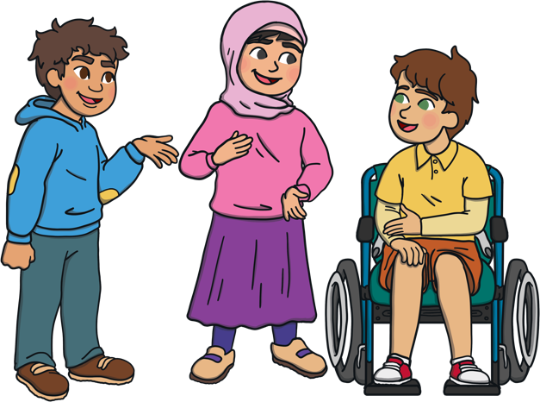
Welcome Page
Online Gaming
Making Friends
Online Bullying
Sharing Information
www.onlinesafety.com/sharinginformation
Sharing Information
Never share any of your personal information online, such as your name, address or school.
Instead of using a photograph, use an avatar to represent your face.
Before you share a photograph of you or your friends online, check with a trusted adult.
If you get sent a photograph that upsets you, tell a trusted adult.

Slide 9
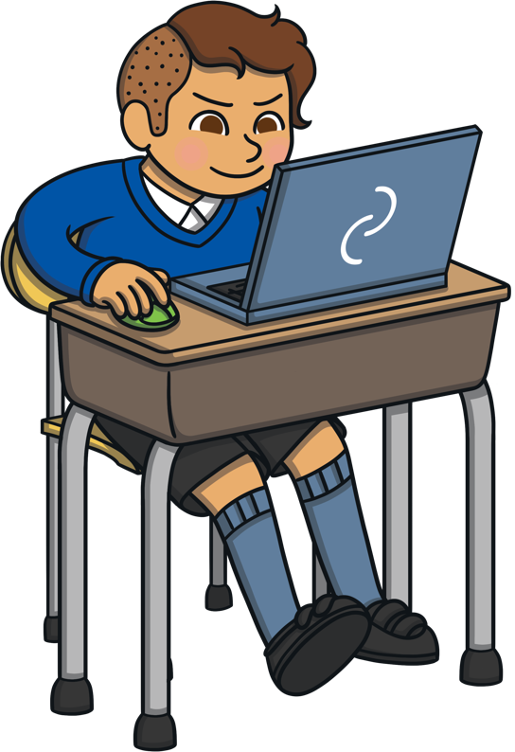
Welcome Page
Online Gaming
Making Friends
Online Bullying
Sharing Information
STOP CLOSE TELL
STOP - Stop what you are doing. Do not click on the page or reply to any messages.
CLOSE - Close the laptop. Put your phone or tablet down.
TELL - Tell a trusted adult.

